Slide 1
Modeling Climate Change in Togo
Jacob Englert, Northern Kentucky University
Notes:
Good evening, everyone. My name is Jacob and today I will be talking about an interesting project I have been working on for the better part of this year. That project is the modeling of climate change in Togo, Africa.

Slide 2
Background Of Togo
West African nation bordered by Ghana, Burkina Faso, and Benin
Capital city of Lomé lies on the coast of the Gulf of Guinea
Population: 7.9 million
Gained full independence from France in 1960
Notes:
First I would like to introduce all of you to Togo as it is not exactly the most popular country in the world. Togo is located in West Africa, with the Gulf of Guinea to the South, Ghana to the West, Burkina Faso to the North, and Benin to the East. The capital, Lomé, can be found on the gulf coast.
Togo gained its independence from France in 1960 and currently sports a population of approximately 7.6 million people.

Slide 3
Project Background
Togolese contact: Binao
Applied Mathematical Models Class, Spring 2018
How are temperatures changing throughout Togo, and what are the implications of this?
65% of Togolese work in agriculture
Agriculture accounts for more than 25% of GDP
67% of land is used for agriculture
Notes:
One might ask, “Why Togo?” This is a fair question, so here is a little background on the project.
Professor Andrew Long’s brother-in-law Binao works for the Togolese government. He provided the data and asked for us to see what we could make of it. The project originally began as part of a Spring 2018 Applied Mathematical Modeling course taught by Dr. Long, but has since evolved into much more.
The primary research question is this: How are temperatures changing over time throughout Togo and what are the implications of this?
The first part of this question is addressed in the research, but the it is important to understand the implications as well. Agriculture is a huge aspect of life of the Togolese. Two-thirds of the population works in agriculture, and despite keeping much of the yield for domestic use, nearly half of all Togolese are underfed. Changing climate patterns disturb the growing season and could result in an even greater shortage of food and jobs than there already is.

Slide 4
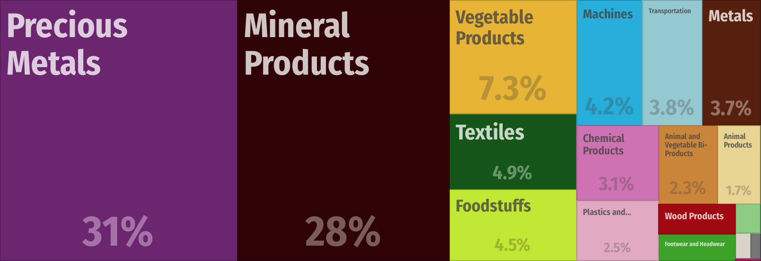
Project Background - Implications
2016 – $1.79 Billion in exports
https://atlas.media.mit.edu/en/profile/country/tgo/

Slide 5
Description of Data
What?
Where?
Minima (°C)
Maxima (°C)
10 Representative Cities
When?
How?
January 1961 -December 2015
Monthly Average
Notes:
The data provided by Binao described average monthly minima and maxima temperatures across a time period of 55 years for 10 different, representative cities in Togo.

Slide 6
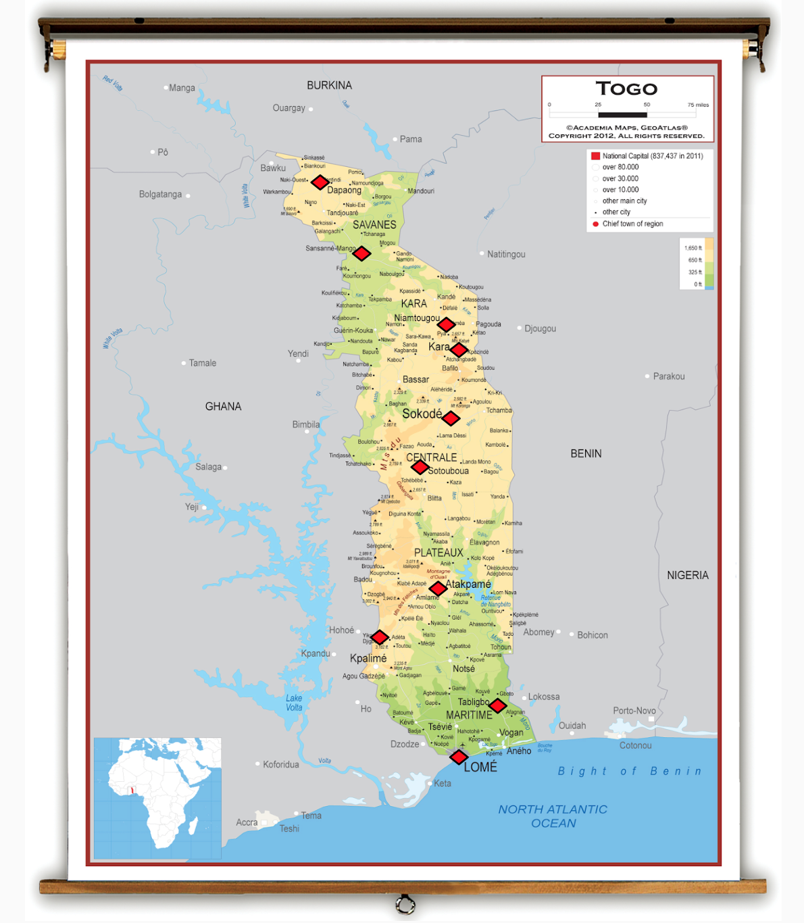
From North to South:
Dapaong
Mango
Niamtougou
Kara
Sokodé
Sotouboua
Atakpamé
Kouma-Konda
Tabligbo
Lomé
Notes:
The data was provided for the following ten cities. Ordered from North to South we have: Dapaong, Mango, Niamtougou, Kara, Sokodé, Sotouboua, Atakpamé, Kouma-Konda, Tabligbo and Lomé

Slide 7
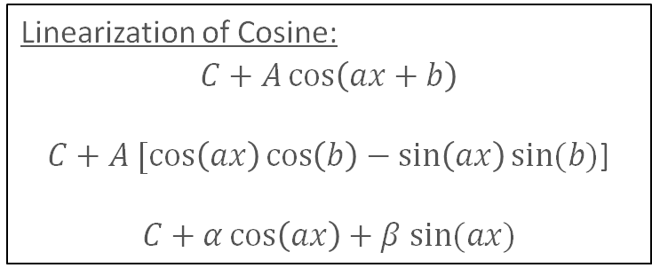
MAT 375 Contributions
Data Cleaning
Flagged outliers and suspicious measurements for removal before modeling
Modeling
Two linear regression models
Capturing Seasonality
Linearization of Cosine:
$$C+A\cos\left(ax+b\right)$$
$C+A [\cos\left(ax\right)\cos\left(b\right)−\sin\left(ax\right)sin⁡(b)$]
$$C+α\cos\left(ax\right)+β sin⁡(ax)$$
Notes:
The accomplishments of the class were really two-fold in nature. The data management crew flagged outliers and suspicious data. After dropping this data, two linear regression models were created: one for temperature minima and one for temperature maxima. In order to capture the seasonality of the data, pairs of sines and cosines were used. This allowed linear regression to be used to capture the phase shift and amplitude of a given period length. All we needed to do was supply the period length.

Slide 8
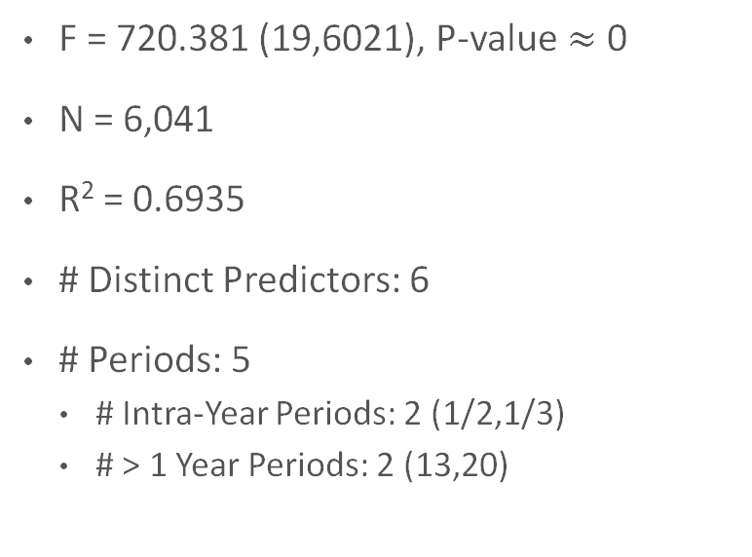
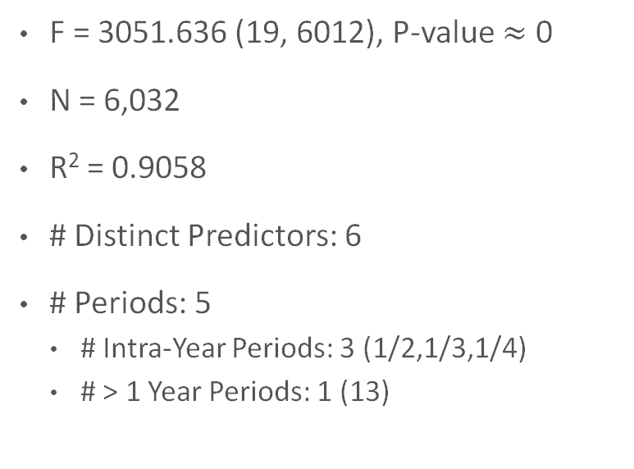
MAT 375 Contributions
Temperature Minima Model
Temperature Maxima Model
F = 720.381 (19,6021), P-value $≈$ 0
N = 6,041
R² = 0.6935
# Distinct Predictors: 6
# Periods: 5
# Intra-Year Periods: 2 (1/2,1/3)
# > 1 Year Periods: 2 (13,20)
F = 3051.636 (19, 6012), P-value $≈$ 0
N = 6,032
R² = 0.9058
# Distinct Predictors: 6
# Periods: 5
# Intra-Year Periods: 3 (1/2,1/3,1/4)
# > 1 Year Periods: 1 (13)

Slide 9
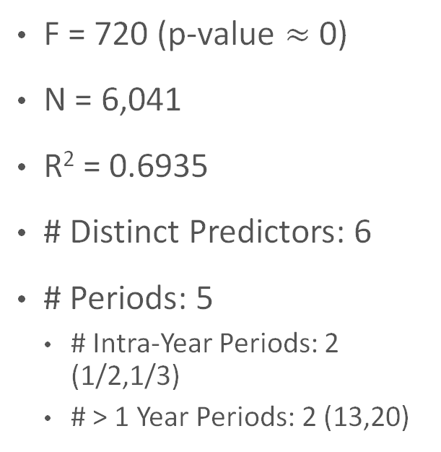
Temperature Minima
F = 720 (p-value $≈$ 0)
N = 6,041
R² = 0.6935
# Distinct Predictors: 6
# Periods: 5
# Intra-Year Periods: 2 (1/2,1/3)
# > 1 Year Periods: 2 (13,20)

Slide 10
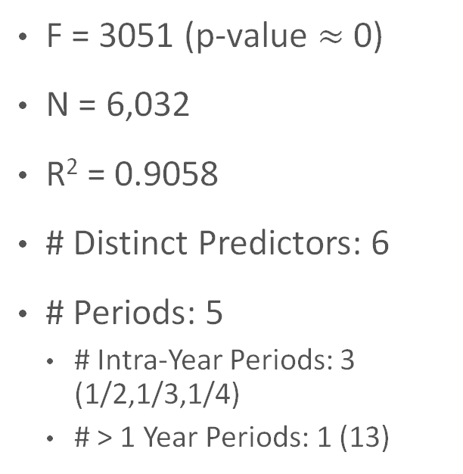
Temperature Maxima
F = 3051 (p-value $≈$ 0)
N = 6,032
R² = 0.9058
# Distinct Predictors: 6
# Periods: 5
# Intra-Year Periods: 3 (1/2,1/3,1/4)
# > 1 Year Periods: 1 (13)

Slide 11
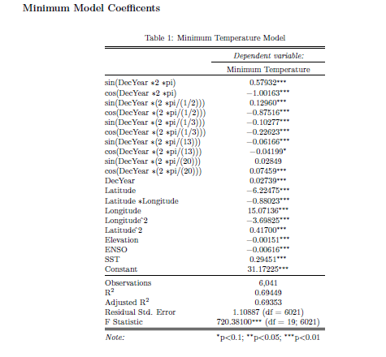
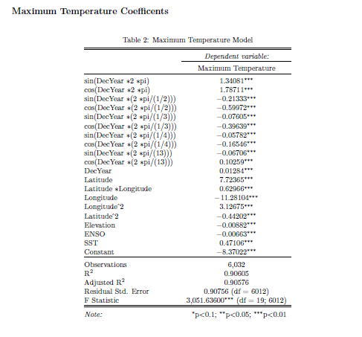
MAT 375 Accomplishments

Slide 12
Description of Final Dataset
Sea Surface Temperature
Decimal Year
El Niño Southern Oscillation
Minimum (°C)
Location
Maximum (°C)
Geography
Latitude
Longitude
Elevation
Notes:
These were the variables included in the final dataset. Note that there are 6 distinct predictors, two responses, and one extra unused but helpful variable, location.

Slide 13
Goals of Continuation
Problem 1: Periods were manually selected
Solution: Systematize period selection to remove subjectivity
Problem 2: Physical geography of Togo not taken into account in either model
Solution: Incorporate variable to account for mountainous region
Problem 3: Linear regression used exclusively, but forecasts are desired
Solution: Find another way to model with time series
Notes:
After school let out in May, there was still unfinished business with this project. This is where I took sole control of the project under Dr. Long’s supervision. We had three problems with the way things had been done in class:
Problem 1: Periods had been manually selected. We needed a way to take the subjectivity out of the process.
Problem 2: Physical geography of Togo had not been taken into account. Elevation, latitude and longitude alone cannot describe the effect of a mountain range.
Problem 3: Linear regression was used exclusively. This is not necessarily a problem, as you will see my next goal was to make yet another regression model. However, in the long term we would like to forecast for future time periods, and this requires using alternative techniques.

Slide 14
The Togo Mountains
Mountain range divides Togo in half
Elevation, latitude, and longitude not good enough
Introduction of categorical variable
Possible values:
L (to the west of the mountains)
M (in the mountains)
R (to the east of the mountains)
Outlier: Kouma-Konda
Notes:
One other item that was very important in selecting long-term periods was the inclusion of a categorical variable to track city location respective to the Togo Mountains. It makes sense that locations on opposite sides of a large mountain chain might experience vastly different weather patterns. Including this variable provided a significant contribution to the model and also played a role in the period selection process.

Slide 15
Systematizing Period Selection
Singular Spectrum Analysis (SSA)
Extension of the singular value decomposition
Requires complete data
Still somewhat subjective
Individual Analysis City by City
Detrend time series
“Pull apart” periods
Get list of estimated periods
Notes:
My first goal was to systematize the period selection process. This was done using singular spectrum analysis, a technique that comes from the singular value decomposition theorem. However, it requires complete data (no missing values). If only there were some model that could effectively impute for missing data and outliers. Oh wait, there is! I used the model from the class as a starting point for this portion of the project.
I soon found that my objective technique was still quite subjective. This is the nature of the way things go. The process is as follows:

Slide 16
SSA Example
Eigenvector | Period
1 | 4.002
2 | -4.002
3 | 6.001
4 | -6.001
5 | 44.886
6 | -44.886
7 | 11.990
8 | -11.990
9 | 15.552
10 | -15.552

Slide 17
SSA Results (Minima)

Slide 18
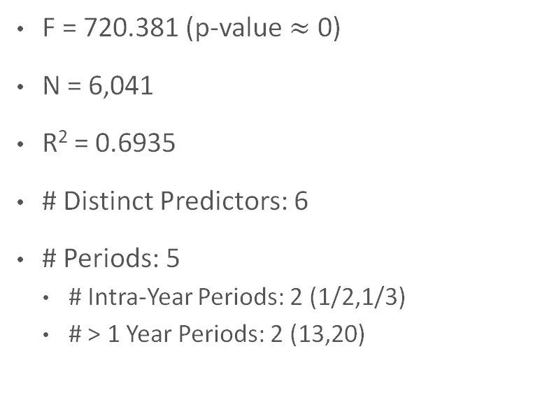
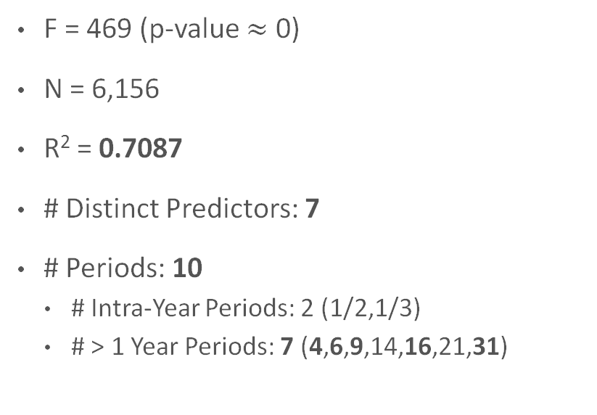
Model Improvements: Minima
Old Minima Model
New Minima Model
F = 720.381 (p-value $≈$ 0)
N = 6,041
R² = 0.6935
# Distinct Predictors: 6
# Periods: 5
# Intra-Year Periods: 2 (1/2,1/3)
# > 1 Year Periods: 2 (13,20)
F = 469 (p-value $≈$ 0)
N = 6,156
R² = 0.7087
# Distinct Predictors: 7
# Periods: 10
# Intra-Year Periods: 2 (1/2,1/3)
# > 1 Year Periods: 7 (4,6,9,14,16,21,31)

Slide 19
SSA Results (Maxima)

Slide 20
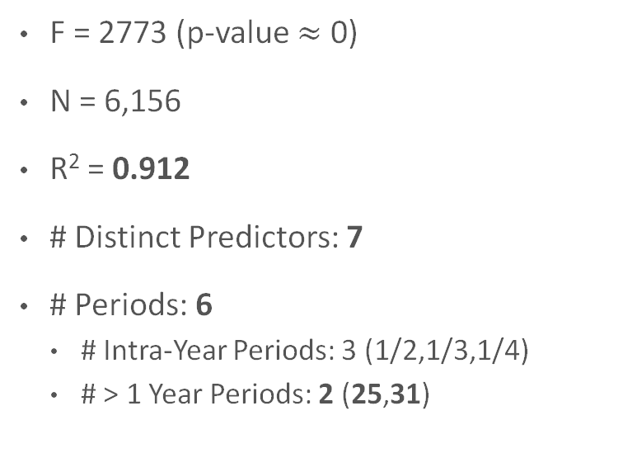
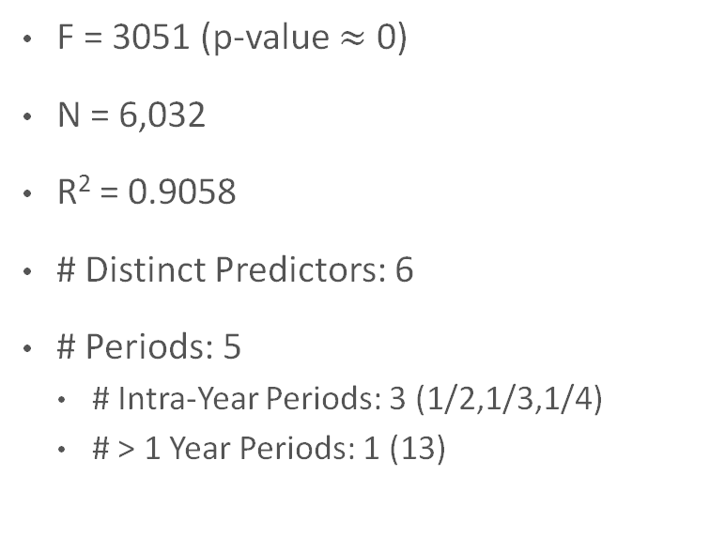
Model Improvements: Maxima
Old Maxima Model
New Maxima Model
F = 3051 (p-value $≈$ 0)
N = 6,032
R² = 0.9058
# Distinct Predictors: 6
# Periods: 5
# Intra-Year Periods: 3 (1/2,1/3,1/4)
# > 1 Year Periods: 1 (13)
F = 2773 (p-value $≈$ 0)
N = 6,156
R² = 0.912
# Distinct Predictors: 7
# Periods: 6
# Intra-Year Periods: 3 (1/2,1/3,1/4)
# > 1 Year Periods: 2 (25,31)

Slide 21
New Temperature Models
Annual Estimates:
+0.019 °C
+0.028 °C

Slide 22
Temperature Minima
Annual Estimate:
+0.028 °C
Notes:
The average annual increase in minimum temperature, controlled for seasonal and cyclical variation, is 0.028 degrees, an increase from 0.027 in the previous model.

Slide 23
Temperature Maxima
Annual Estimate:
+0.019 °C
Notes:
The average annual increase in temperature, controlled for seasonal and cyclical variation, is 0.019 degrees, an increase from 0.013 in the previous model.

Slide 24
Future Goals
Scaling period amplitude by latitude
Multivariate period selection
Forecasting
How warm will temperatures be in 2100?
Multivariate techniques using SSA
Notes:
One might say, that looks like a whole lot of work just to explain slightly more variation in your data, and you would be right! But not only did the new models do a better job of isolating annual trend, we now have a true explanation for choosing the periods we did. Nonetheless, there is still plenty to be done. Possible future work could include scaling period amplitude based on geographical parameters, repeating the process until periods converge, using a multivariate period selection system that looks at all cities at once, and forecasting.

Slide 25
Special Thanks To
The Sehnert-Pugh Fund
Professor Andy Long

Slide 26
Image Sources
https://eros.usgs.gov/westafrica/ecoregions-and-topography/ecoregions-and-topography-togo
https://www.netmaps.net/netmaps/togo-vegetation-map/
https://atlas.media.mit.edu/en/profile/country/tgo/
https://www.cia.gov/library/publications/the-world-factbook/geos/to.html

